Slide 1
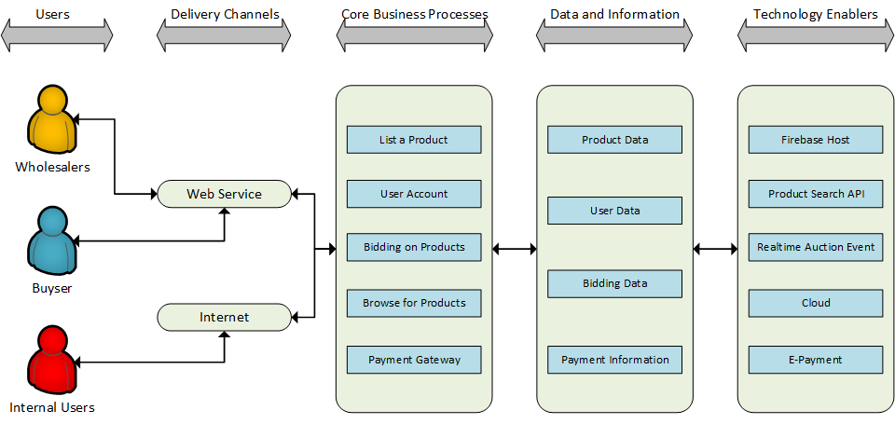
BundleBid Web Application Architecture Type: Application Architecture View: Logical View Style: Layered Architecture Pattern

Slide 2
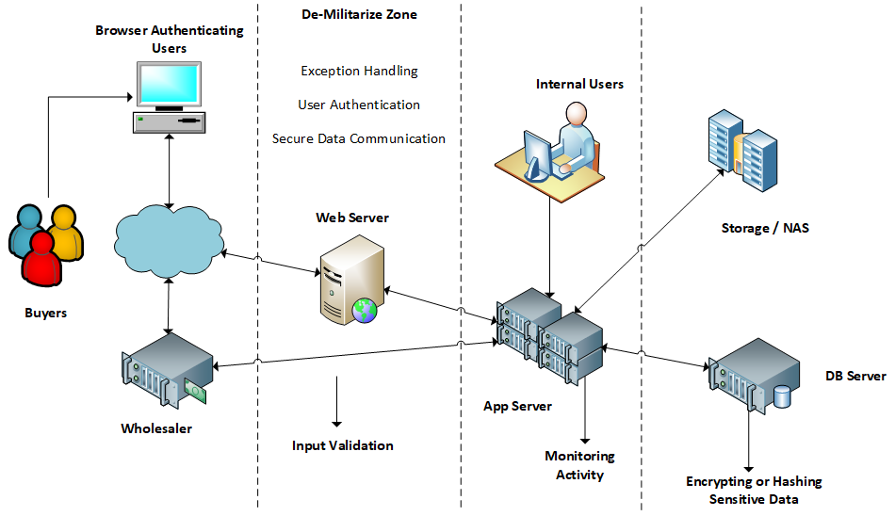
BundleBid Web Application Architecture Type: Application Architecture View: Process View Style: Client-Server Architecture Pattern

Slide 3
Architecture diagrams are high level design diagrams that visualize the design process and define the system architecture. It identifies the major components that make up the system and the flow of interactions. We use it to visualize the overall structure of the application to ensure that the system meets our need. It is a blueprint of development.
The logical view provides a logical process of the application modules. We use it to during development and process. It guides us through how each object is connected and interreacting with each other.
We use the process view as a illustration of the application at run-time that the system is composed of interacting process, concurrency and communications elements.

